Slide 1

A Gamified Web based Quiz Platform for Interactive Nursing Education
CYB23IN201 Internship -II
First Review
Date: 5.6.2026 & 6.6.2026
Presenter
G L Swaminathan (E0224033)
Project Guide
Dr. G. Jayanthi

Slide 2
INTRODUCTION
Need for the technology:
Domain based platforms are hard to find publicly on the Internet. Usually Interactive Quizzes and Quiz Platforms that are publicly available are general for all and that is user specific. But each domain, each department should have their own basic modules and questions that can be used irrespective of their syllabus. As I am Collaborating with SRIHER’s Nursing Department, this need of technology had fall into my eyes
Applications:
Interactive Learning
Experience points-based level progression
User centric customization
Day to Day Leaderboard Update
Different Question Modes
Domain based Modules
Live Quiz
And more…

Slide 3
Motivation behind the study:
The Motivation is that a study on how the Gamified or interactive learning implies effective learning among students. As an existing Technology, Kahoot, way ground and Mentimeter gives various features and interactivity for students. This makes the learning heartful and easy to remember. So, this motivates to create a Module based quizzes and level-based progression to consistent incoming of specific Department students irrespective of their syllabus. Thus, Motivation is to study the effectiveness
Challenges to be addressed:
Handling Multiple Users at once (Scaling)
Creating Creative Question Modes
Selecting Suitable UI
Thinking of creative features to add
Making it portable for Multi Device
Designing User-centric customizations
Implementing security measures for security of the website

Slide 4
REVIEW OF LITERATURE (Minimum 15 Works)
Author and Year (chronological order) | Methodology/ Materials and Methods | Datasets | Results/Outcome | Advantage / Key findings from the work | Disadvantage/ GAP Identified from the work

Slide 5
REVIEW OF LITERATURE (Minimum 15 Works Continued….)
Author and Year (chronological order) | Methodology/ Materials and Methods | Datasets | Results/Outcome | Advantage / Key findings from the work | Disadvantage/ GAP Identified from the work

Slide 6
REVIEW OF EXISTING SYSTEM (S/W/H/W PRODUCTS, TOOLS)
Author /Developer Year (chronological order) | Methodology/ Materials and Methods | Datasets | Results/Outcome | Advantage / Key findings from the work | Disadvantage/ GAP Identified from the work

Slide 7
PROBLEM STATEMENT
Traditional nursing education relies on passive learning methods (lectures, static PDFs, paper-based tests), leading to low student engagement, limited real-time assessment, and no personalized feedback — especially in clinical skill-building scenarios.
→Lack of engagement
→No competitive assessment
→Limited question formats
→Poor accessibility
A full-stack web platform with gamified learning (XP, ranks, badges), real-time multiplayer quizzes via WebSockets, 6 multimedia question types, role-based access (Teacher/Student), and modular curriculum management — built with React 19, Node.js/Express 5, Socket.IO, and SQLite.
To create a Web App or an Website for Quiz platform which includes Nursing specific question modules that any Nursing Student can attend irrespective of their Syllabus.
We’ve used React+vite and the middleware as Node+Express.js. RESTful API handles the routing, middleware routing, file uploads and DB operations.
Using SQLite (better-sqlite) for serverless, lightweight use for Database.
Web Sockets to enable live, real-time multiplayerquiz sessions where a teacher hosts and students join via a game code.

Slide 8
OBJECTIVES
Objective - 1 :
To design a full-stack gamified nursing education platform (React, Node.js, Express, SQLite) with role-based access control, interactive dashboards, and a comprehensive quiz management system.
Objective - 2:
To implement multimedia-rich question types — MCQ, image-based, video-based, audio-based, jumbled-letter, and sequence ordering — enabling varied and engaging assessments beyond traditional text-only quizzes.
Objective - 3:
To integrate nursing-specific learning features including categorized clinical quizzes, module-based organization, scenario-based assessments, and domain-relevant gamification (XP, levels, streaks, badges).
Objective - 4:
To enable real-time multiplayer quiz sessions via Socket.IO with multi-device access, instant scoring, live leaderboards, and synchronized question delivery.
Objective - 5:
To ensure production-readiness through robust security (JWT, bcrypt, input validation), scalable single-server architecture, and real-world deployment

Slide 9
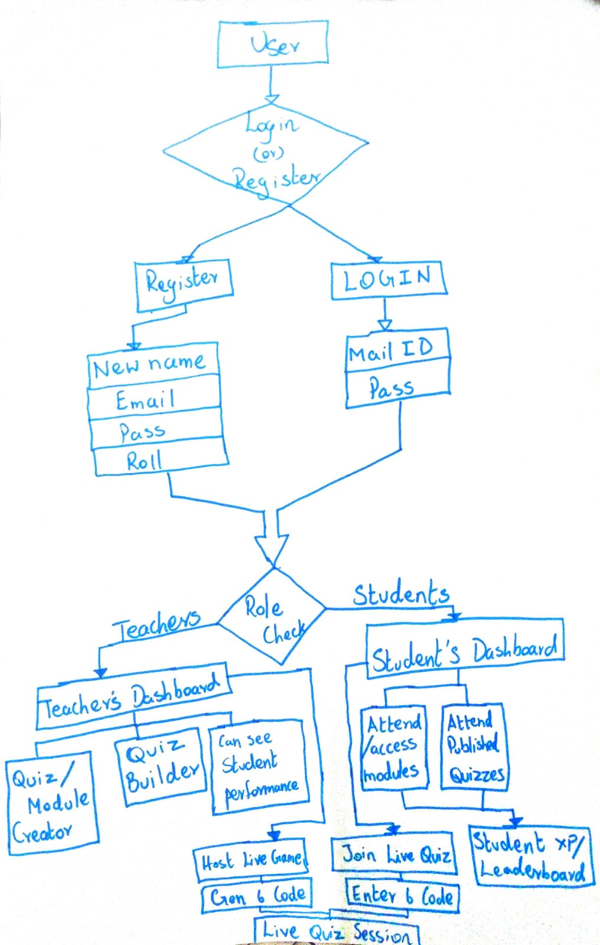
WORKFLOW DIAGRAM

Slide 10
MODULES
# | Modules | Methodology / Algorithm | Technologies (H/W and S/W) | Implementation
1 | Frontend Module (UI Layer) | Component-based SPA; client-side routing; Context API state management | S/W: React 19, Vite, React Router, Three.js, Lottie | 11 pages, reusable components, 2 context providers, API client
2 | Backend API Module (Server Layer) | RESTful API; MVC pattern; middleware chaining; MIME-filtered uploads | S/W: Node.js, Express 5, Multer, CORS with Node.js 18+ server | 5 route modules, file upload endpoint, media handler
3 | Auth Module (Security Layer) | JWT token auth; bcrypt hashing (salt=10); role-based access control | S/W: jsonwebtoken, bcryptjs, Express middleware | Token sign/verify, password hashing, role-gating middleware
4 | Database Module (Data Layer) | Relational schema; prepared statements; WAL journaling; auto-migration | S/W: SQLite, better-sqlite3, UUID H/W: Local file storage | 6 tables, schema.sql, init.js with migrations, seed.js
5 | Real-Time Module (WebSocket Layer) | Event-driven pub/sub; room-based sessions; Kahoot-style scoring | S/W: Socket.IO, Node.js event loop | Session lifecycle, in-memory store, live scoring & ranking

Slide 11
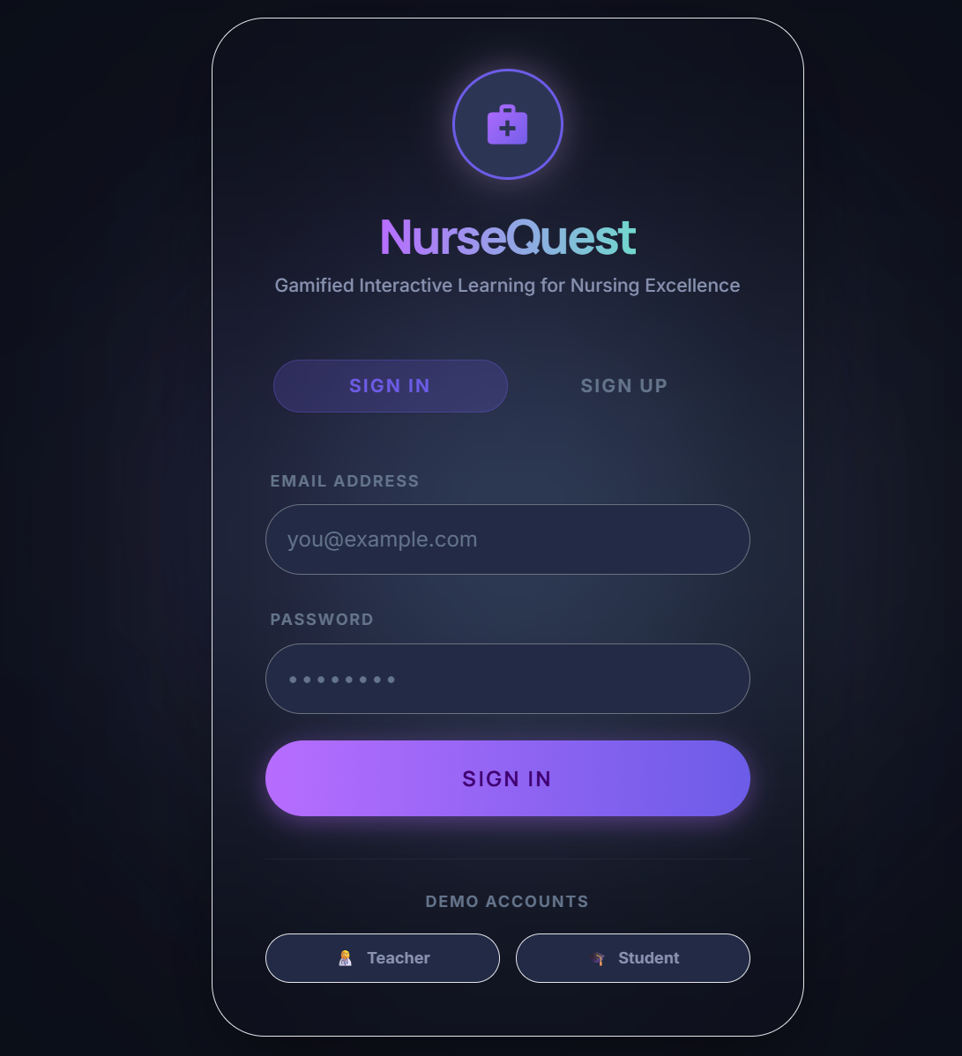
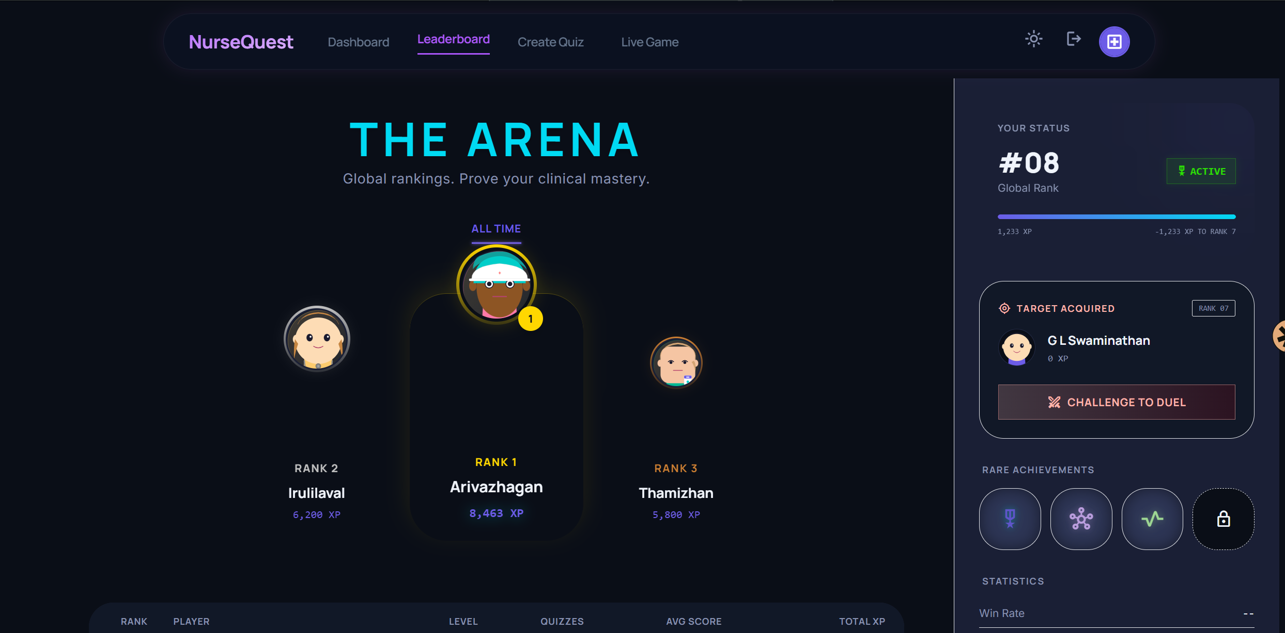
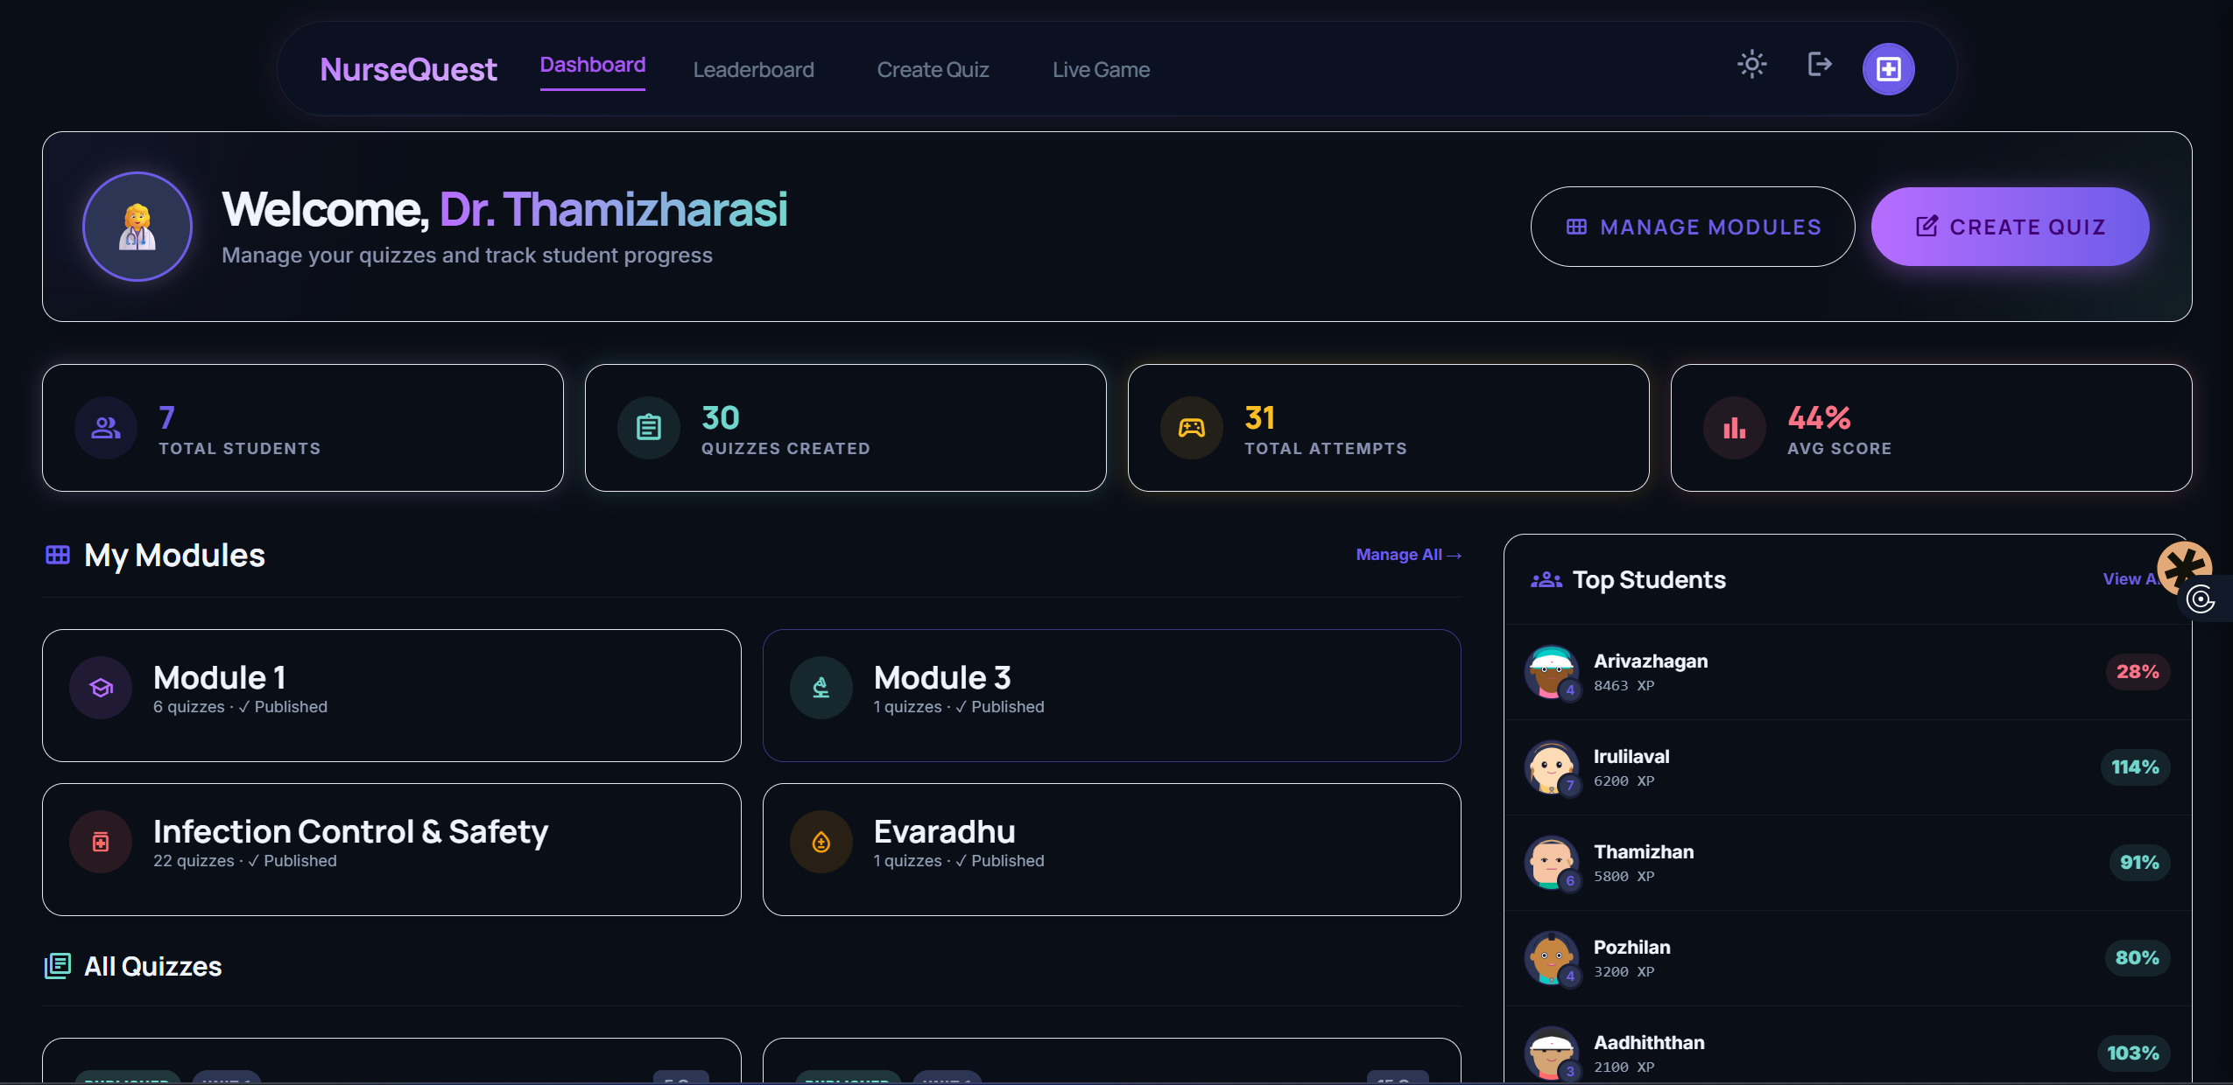
TENTATIVE RESULTS/ EXPECTED OUTCOME

Slide 12
CONCLUSION
#Conclusion section must be present in all review presentations.
# For first review, specify the work progressed until 13 MAR 25/ 15 MARCH 25 in bullet points
Like status of Review of Literature,
Progress in implementation etc.

Slide 13
REFERENCES
[1] R. Nguyen, "Advancing Nursing Education Through Gamification," Am. J. Nurs., vol. 126, no. 6, pp. 8-9, Jun 2026.
[2] A. Azoulay and F. Lim, "The Impact of Gamification on Academic Performance: An Integrative Review," Nurs. Educ. Perspect., vol. 47, no. 3, pp. 160-167, May 2026.
[3] S. Aalaei, et al., "Design and evaluation of a gamified mobile application for teaching cardiac rhythm interpretation," BMC Med. Educ., vol. 26, no. 1, p. 882, Apr 2026.
[4] M. AlMekkawi, et al., "Game-based learning in undergraduate nursing education: A systematic review," Nurse Educ. Today, vol. 164, p. 107124, Sep 2026.
[5] V. I. Bahar, et al., "Effectiveness of Serious Game Activities in Raising Palliative Care Awareness," Comput. Inform. Nurs., vol. 44, no. 6, pp. 14-22, Jun 2026.
[6] K. McMillan, et al., "Gamification design and engagement in preregistration nurse education," BMJ Open, vol. 16, no. 1, p. e107037, Jan 2026.
[7] M. Yang, et al., "Effectiveness of escape room in Chinese nursing education: A systematic review," BMC Nurs., vol. 25, no. 1, p. 201, Feb 2026.
[8] Y. G. S. Barbalho, et al., "A Serious Game (Health Unit in Focus) for Older Adults' Health," JMIR Serious Games, vol. 13, no. 1, p. e66289, Nov 2025.
[9] N. Aktaş and Y. Sazak, "Use of an escape room-based learning strategy to enhance pharmacology knowledge," BMC Nurs., vol. 25, no. 1, p. 106, Dec 2025.
[10] M. White and T. Shellenbarger, "Gamification of nursing education with digital badges," Nurse Educator, vol. 43, no. 2, pp. 78-82, Mar 2018.
[11] S. Mishra, et al., "QuestMitra: A Scalable Multiplayer Gamified Quiz Platform using Node.js and Socket.IO," Int. J. Comput. Sci. Eng., vol. 18, no. 2, pp. 245-251, Feb 2026.
[12] A. Kumar, et al., "Design and Development of a Real-Time Gamified Quiz Application using React and Socket.IO," Int. J. Innov. Res. Comput. Commun. Eng., vol. 13, no. 8, pp. 14671-14678, Aug 2025.
[13] J. Silva and M. Santos, "Comparing SQLite and Embedded Databases for Storage in Web-Based LMS," J. Softw. Eng. Appl., vol. 16, no. 4, pp. 112-120, Apr 2023.
[14] L. Chen and X. Wang, "Full-Duplex Communication in Browser-Based Multiplayer Games: WebSockets vs. WebRTC," IEEE Trans. Games, vol. 17, no. 3, pp. 312-320, Sep 2024.
[15] D. Jones and R. Smith, "Developing Interactive Single Page Applications for Medical Training: A React-Based Approach," Comput. Educ., vol. 188, p. 104581, Oct 2022.

Slide 14
REFERENCES
WEB REFERENCES:
Youtube
AI Platforms(Gemini,ChatGPT,Claude,etc.,.)
AI Builders (Google AI Studio, Stitch.io,etc.,.)
Online Forums (Pinterest,Reddit)
Online Quiz Platforms (Kahoot, Wayground, Mentimeter,etc,.,)
Publishers (ResearchGate, ebc.uk.com, etc,.,)

Slide 15
Thank you

